Slide 1
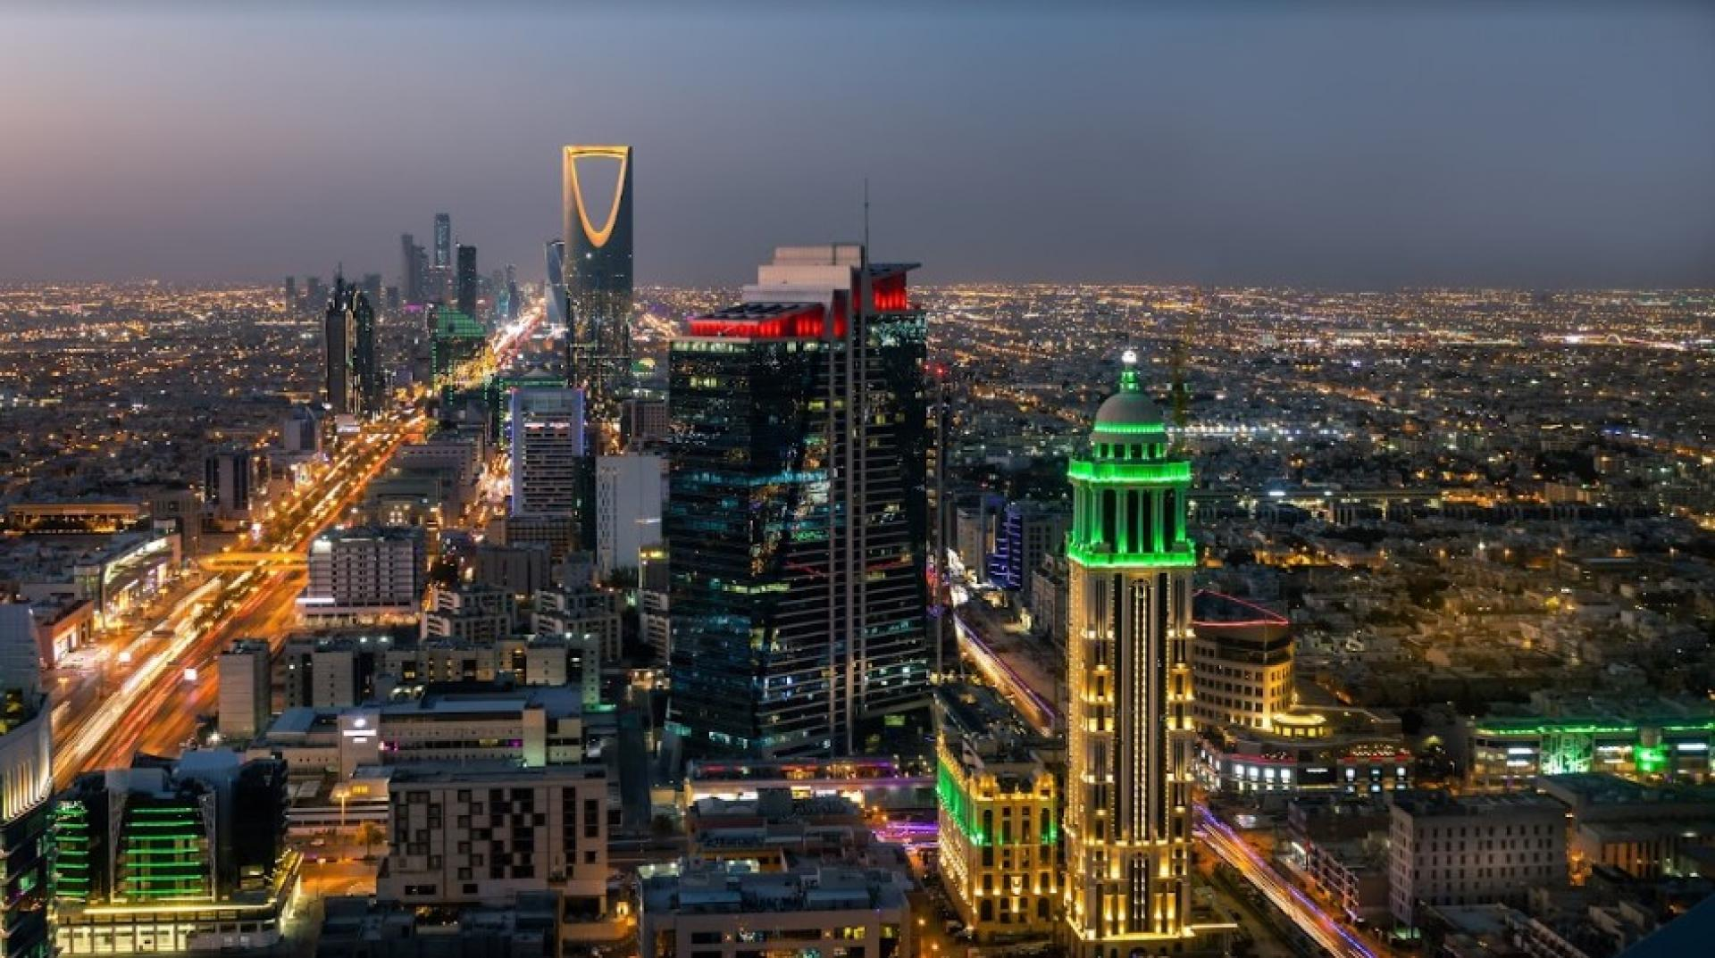
Riyadh Restaurants Clustering

Slide 2
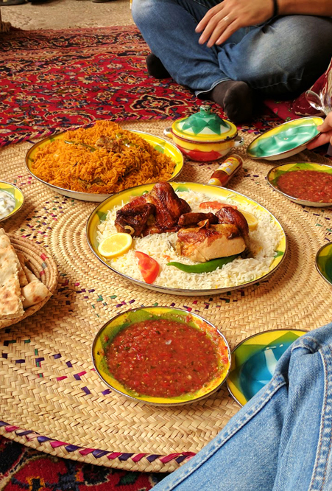
Data Source
Data is extracted from FourSquare website
2300 records in various areas in Riyadh city
Features are encoded for data modeling
Features:
Restaurant name
Rating
Category
Price Range
Libraries used:
Selenium
BeauitifulSoup4
Pandas

Slide 3

Challenges
Used multiple sources to find the optimal dataset
Null values in prices range in both Google maps & FourSquare
Selecting points in each area in Riyadh
Fetching number of ratings in FourSquare
Analyzing reviews needs large dictionary to be done
Lack of equipment performance and connectivity consumed time

Slide 4
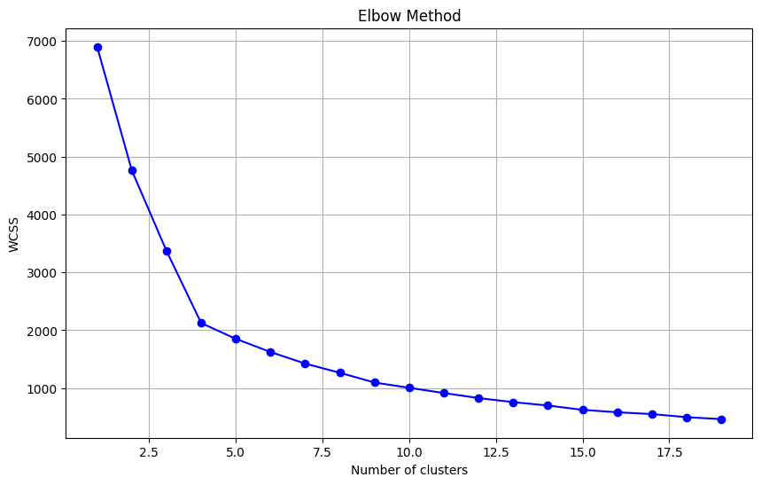
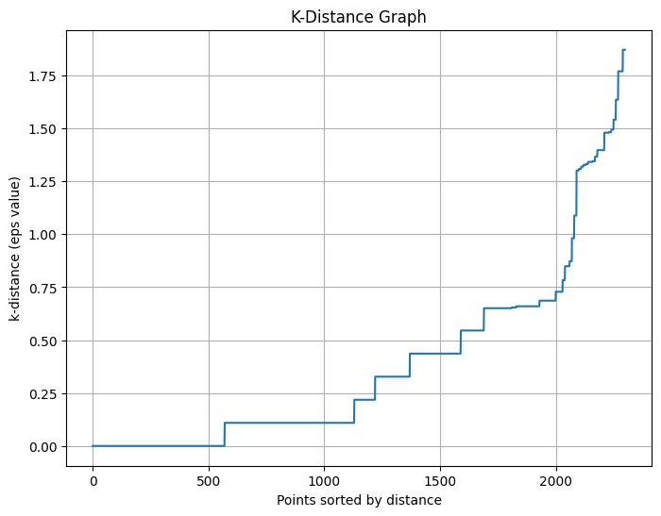
Models
1
KMeans
2
DBSCAN

Slide 5
Deployment
Implemented API using render
Developed Streamlit App

Slide 6
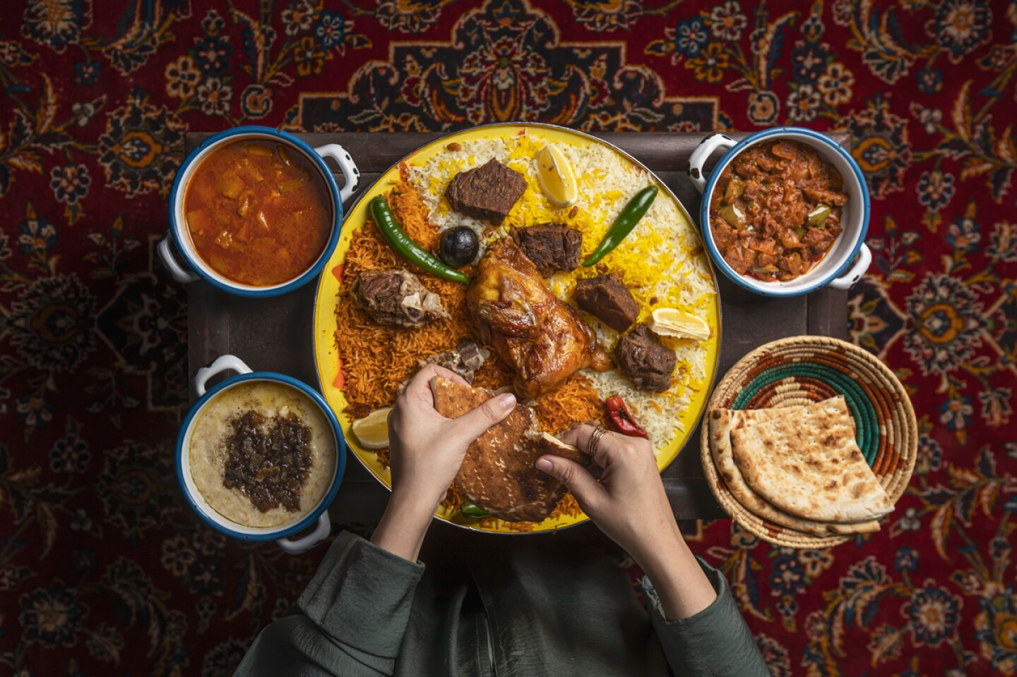

Thank You

